Slide 1
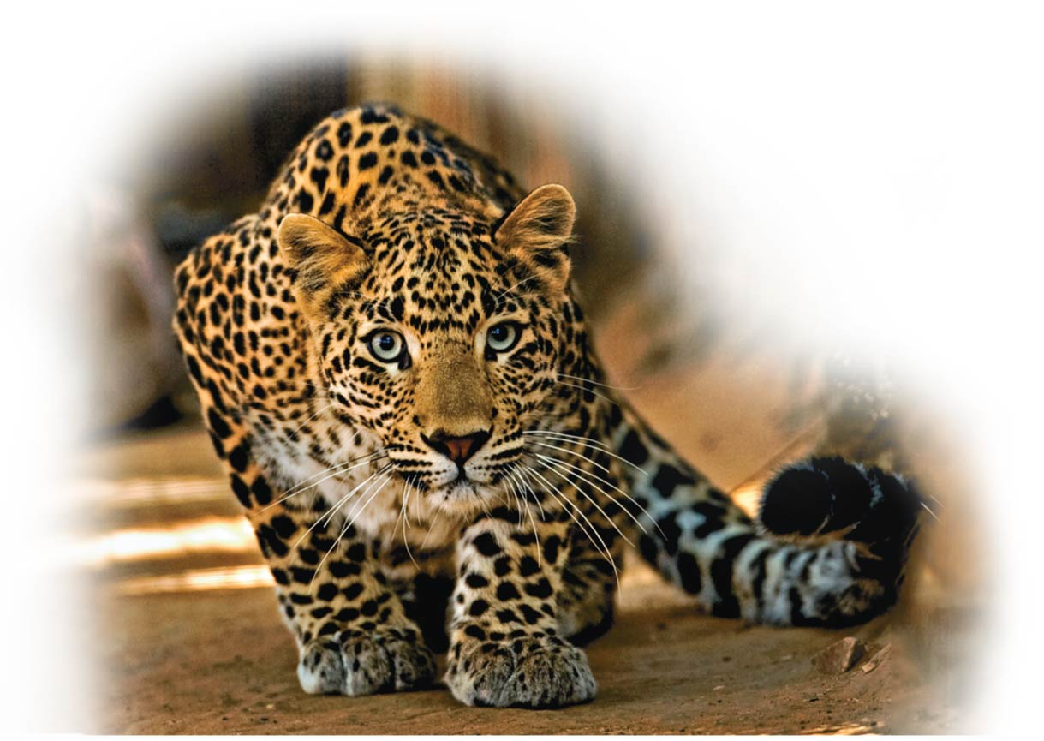
Circulation and Respiration
Unit 5; Chapter 23

Slide 2
Learning Objectives
Describe the function and main components of animal circulatory systems, and compare the structures of different types of circulatory systems.
Describe the path of blood as it makes one full circuit through the human body, including the heart, and compare the function of each structure in enabling this circuit to be completed.
Relate heart rate to blood pressure, explaining how they are controlled and how they are measured.
Describe the components of blood, their functions, and how donation of these components works.
Describe the causes, frequency, treatment, and prevention of cardiovascular disease and blood disorders.

Slide 3
UNIFYING CONCEPTS OF ANIMAL CIRCULATION
  Every organism must exchange materials with its environment, relying on
    diffusion, the spontaneous movement of molecules from an area of higher concentration to an area of lower concentration
    a circulatory system, which facilitates the exchange of materials for all but the simplest animals.
Notes:
3

Slide 4
Circulatory System
  A circulatory system typically consists of a
    central pump
    vascular system
    circulating fluid
Notes:
4

Slide 5
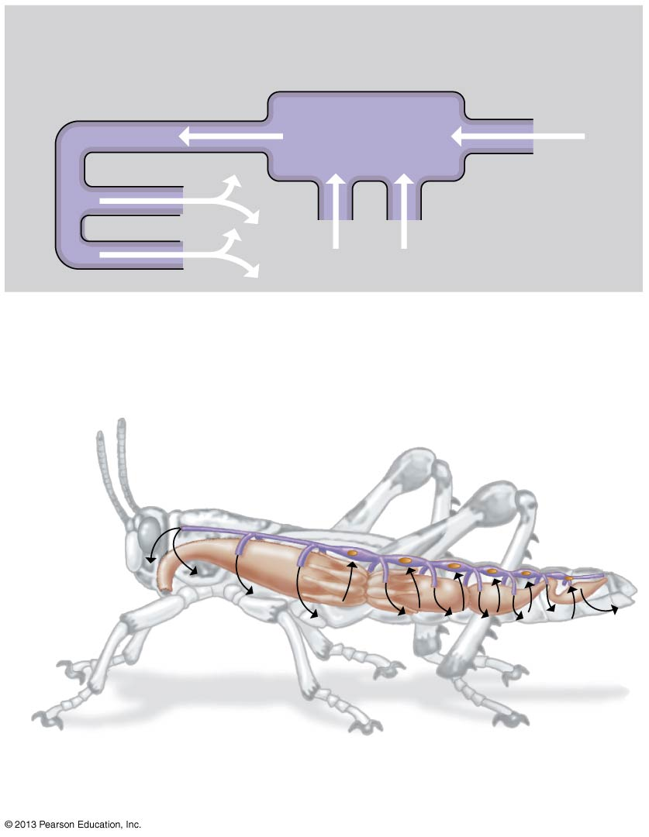
Vessels
Heart
Circulating fluid
Open Circulatory System
Tubular
heart

Slide 6
Circulatory System
  In an open circulatory system,
    the heart pumps blood into large open-ended vessels
    fluid circulates freely among cells
  Open circulatory systems are found in many invertebrates (e.g., arthropods and most molluscs).
Notes:
6

Slide 7
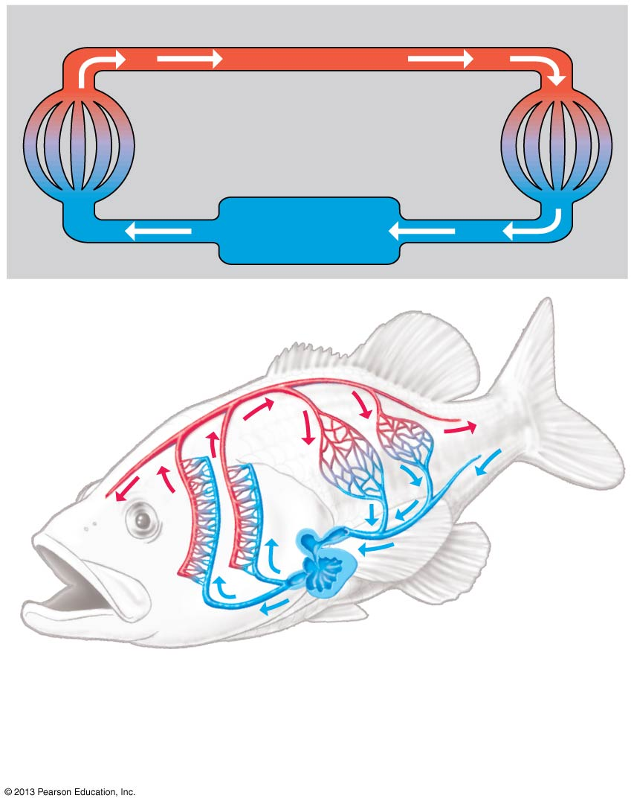
Interstitial fluid
Vessels
Capillaries
Heart
Arteriole
Capillaries
Artery
(O₂-rich
blood)
Closed Circulatory System
Venule
Vein
Atrium
Ventricle
Heart
Vessels
Artery
(O₂-poor blood)

Slide 8
Circulatory System
  In a closed circulatory system, blood
    stays within a set of tubes
    distinct from the interstitial fluid （细胞间质）, the fluid that fills the spaces around cells.
  Closed circulatory systems are found in
    many invertebrates, including earthworms and octopuses
    vertebrates
Notes:
8

Slide 9
Circulatory System
  The cardiovascular system of vertebrates consists of the
    heart
    blood vessels
  In the heart
    the atrium receives blood
    the ventricle pumps blood away from the heart.
Notes:
9

Slide 10
Circulatory System
  Blood is confined to three main types of blood vessels:
    Arteries carry blood away from the heart into smaller arterioles as they approach the organs.
    Capillaries are the site of exchange between blood and interstitial fluid.
    Venules (small veins) collect blood from the capillaries and converge to form veins, which return blood back to the heart.
Notes:
10

Slide 11
The Human Cardiovascular System
  In the human cardiovascular system
    the central pump is the heart
    the vascular system is the blood vessels
    the circulating fluid is the blood
Notes:
11

Slide 12
The Path of Blood
  Humans and other terrestrial vertebrates have a double circulation system consisting of
    a pulmonary circuit between the heart and lungs
    a systemic circuit between the heart and the rest of the body
Notes:
12

Slide 13
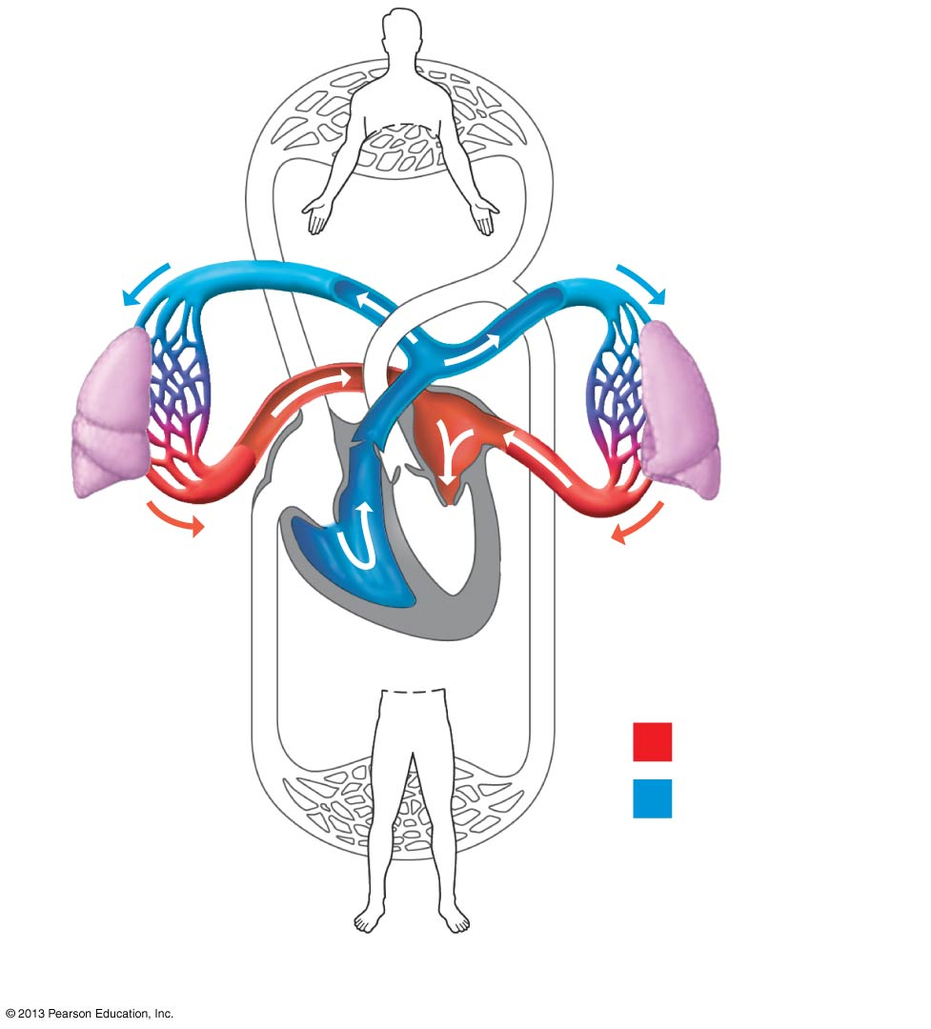
Pulmonary
Circuit
CO₂
CO₂
Lung
Lung
O₂
O₂
Heart
O₂-rich blood
O₂-poor blood

Slide 14
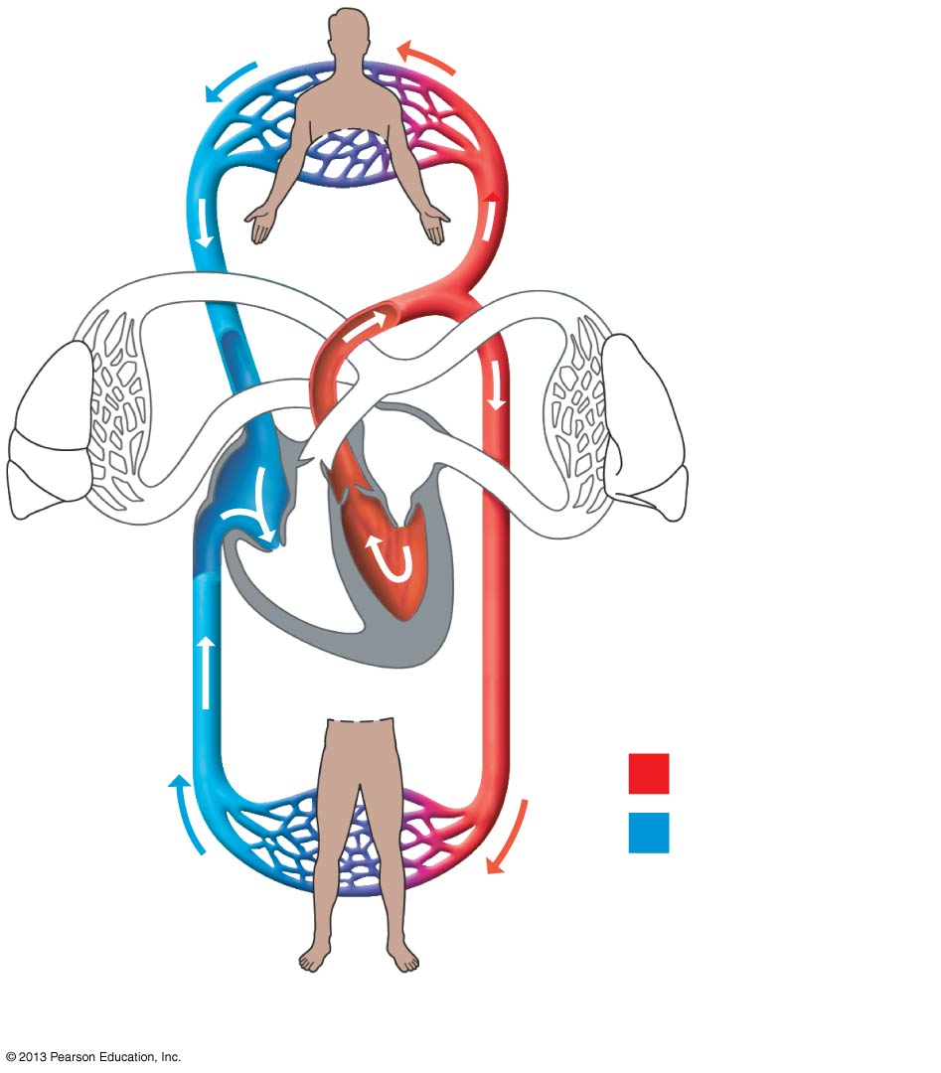
Systemic
Circuit
CO₂
O₂
O₂
O₂-rich blood
O₂-poor blood
CO₂

Slide 15
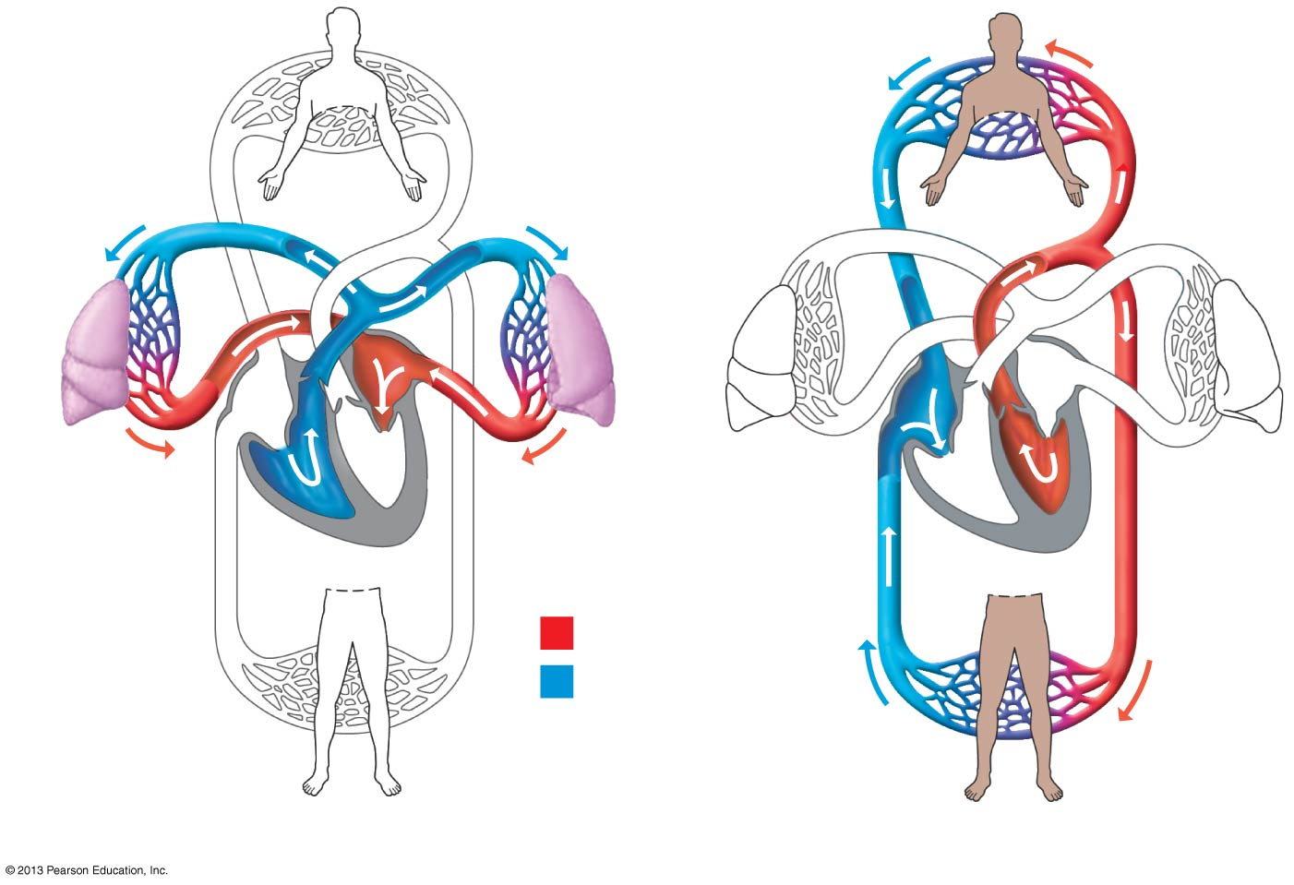
Double Circulation
RIGHT chamber pumps blood RIGHT to the lungs
LEFT chamber receives blood LEFT from the lungs
CO₂
O₂
CO₂
CO₂
Lung
Lung
O₂
O₂
Heart
O₂-rich blood
O₂
O₂-poor blood
CO₂
Pulmonary circuit
Systemic circuit

Slide 16
The Path of Blood
  One complete trip through the human cardiovascular system
    takes about one minute
    requires two passes through the heart
Notes:
16

Slide 17
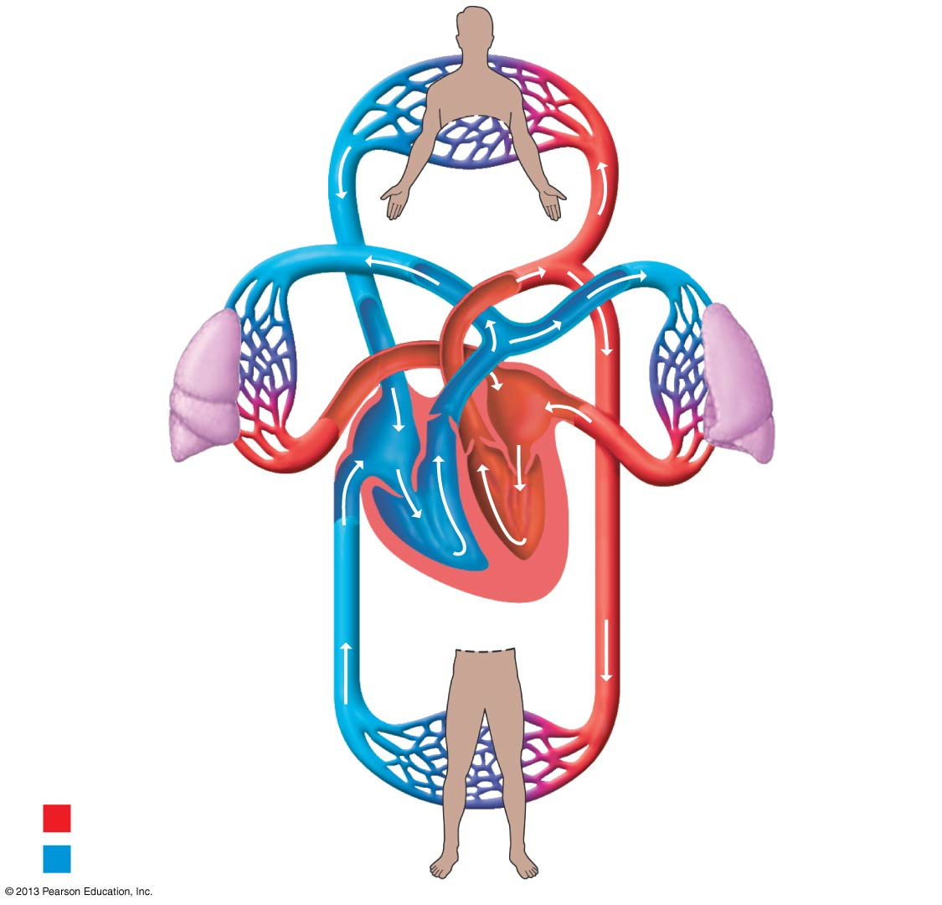
9
Capillaries of
head, chest,
and arms
Superior
vena cava
Pulmonary
artery
Pulmonary
artery
10
Aorta
Capillaries
of right lung
Capillaries
of left lung
3
8
3
A Trip Through the Human Cardiovascular System
4
4
5
6
1
5
Pulmonary vein
7
Pulmonary vein
2
Right atrium
11
Left atrium
Right ventricle
Left ventricle
Inferior
vena cava
Capillaries of
abdominal region
and legs
O₂-rich blood
O₂-poor blood
9

Slide 18
How the Heart Works
  The human heart
    is a muscular organ about the size of a fist
    is located under the breastbone
    has four chambers
Notes:
18

Slide 19
How the Heart Works
  The path of blood flow through the human heart functions as two pumps moving blood between
    the heart and lungs
    the heart and the rest of the body
Notes:
19

Slide 20
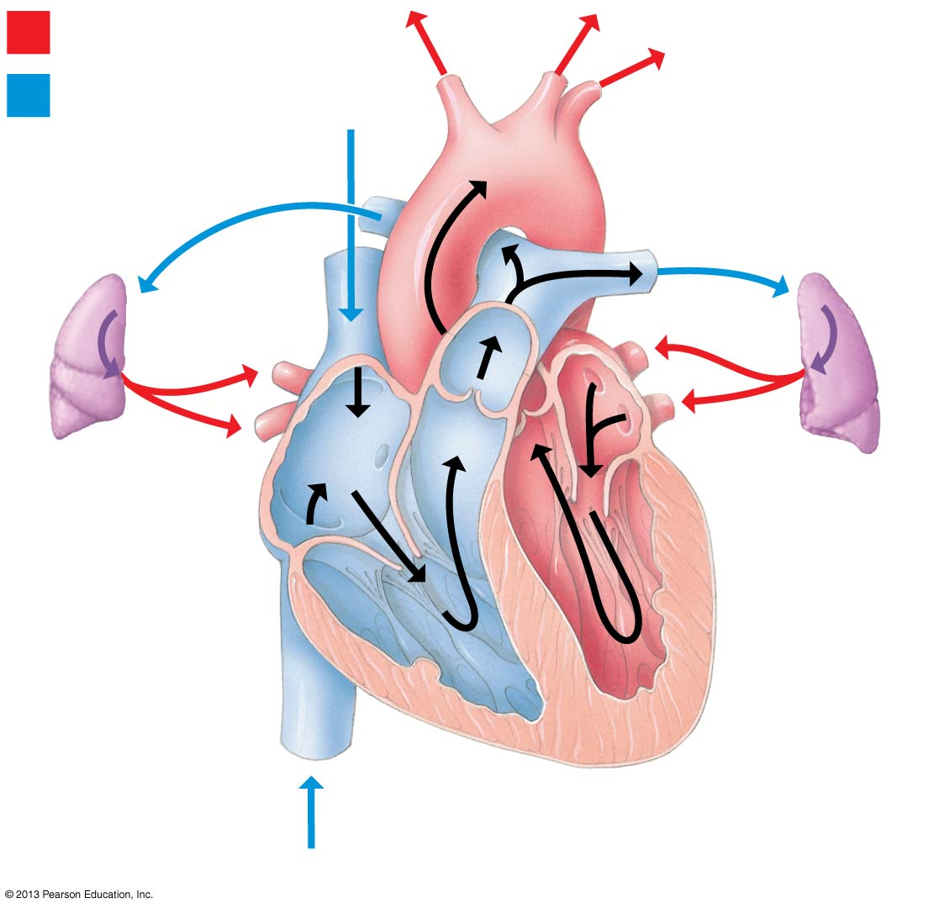
O₂-rich blood
To body
O₂-poor blood
From
body
Right
lung
Left
lung
Path of Blood flow Through the Human Heart
Right atrium
Left atrium
Valves
Valves
Right
ventricle
Left
ventricle
From body

Slide 21
The Cardiac Cycle
  The heart relaxes and contracts throughout our lives.
    Diastole is the relaxation phase of the heart cycle.
    Systole is the contraction phase.
  A heart murmur is a sound that may indicate a defect in one or more of the heart valves.
Notes:
21

Slide 22
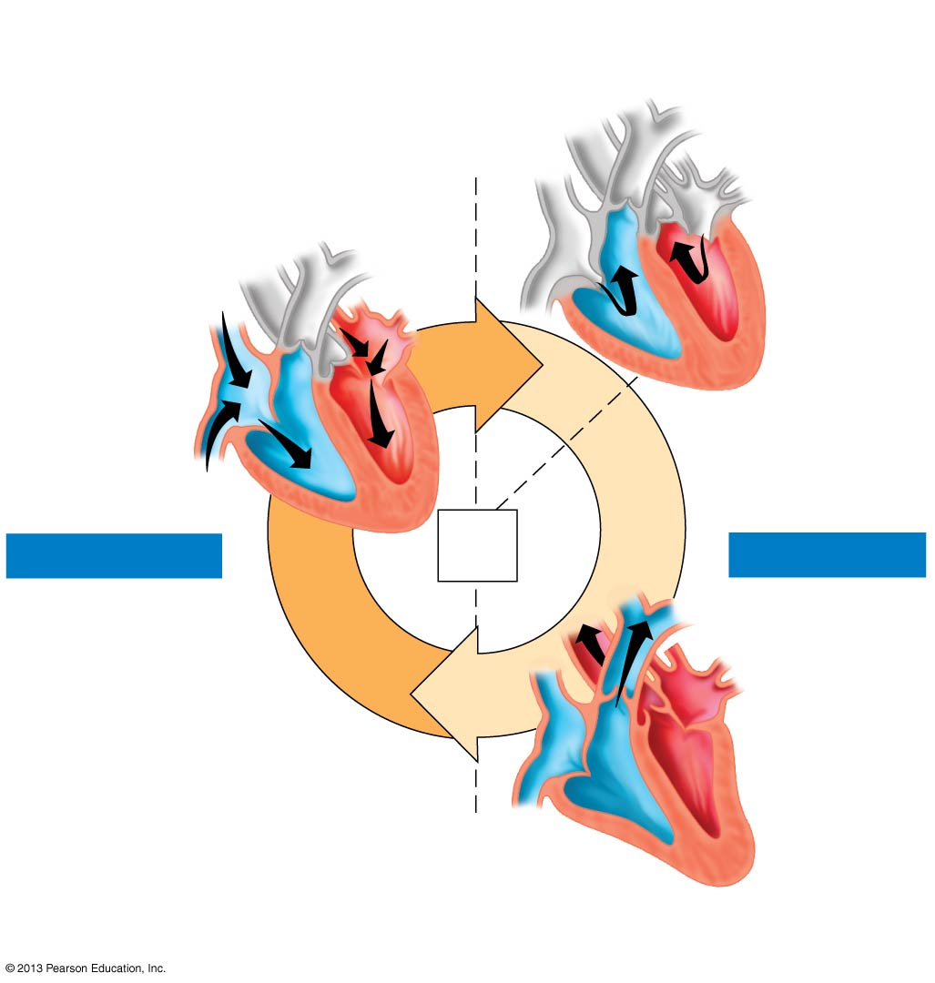
2
Atria contract. Blood is
forced into ventricles.
1
Heart is relaxed.
Blood flows in.
0.1
sec
The Cardiac Cycle
0.8
sec
0.3
sec
DIASTOLE
SYSTOLE
0.4
sec
3
Ventricles contract.
Blood is pumped out.

Slide 23
The Pacemaker and the Control of Heart Rate
  The pacemaker, or SA node (sinoatrial node) （窦房结）,
    sets the tempo of the heartbeat
    composed of specialized muscle tissue in the wall of the right atrium.
  Impulses from the pacemaker spread quickly through the walls of both atria, prompting the atria to contract at the same time.
Notes:
23

Slide 24
The Pacemaker and the Control of Heart Rate
  The AV node (atrioventricular node) (房室结）
    a relay point that delays the signal
    sends impulses to the ventricles
Notes:
24

Slide 25
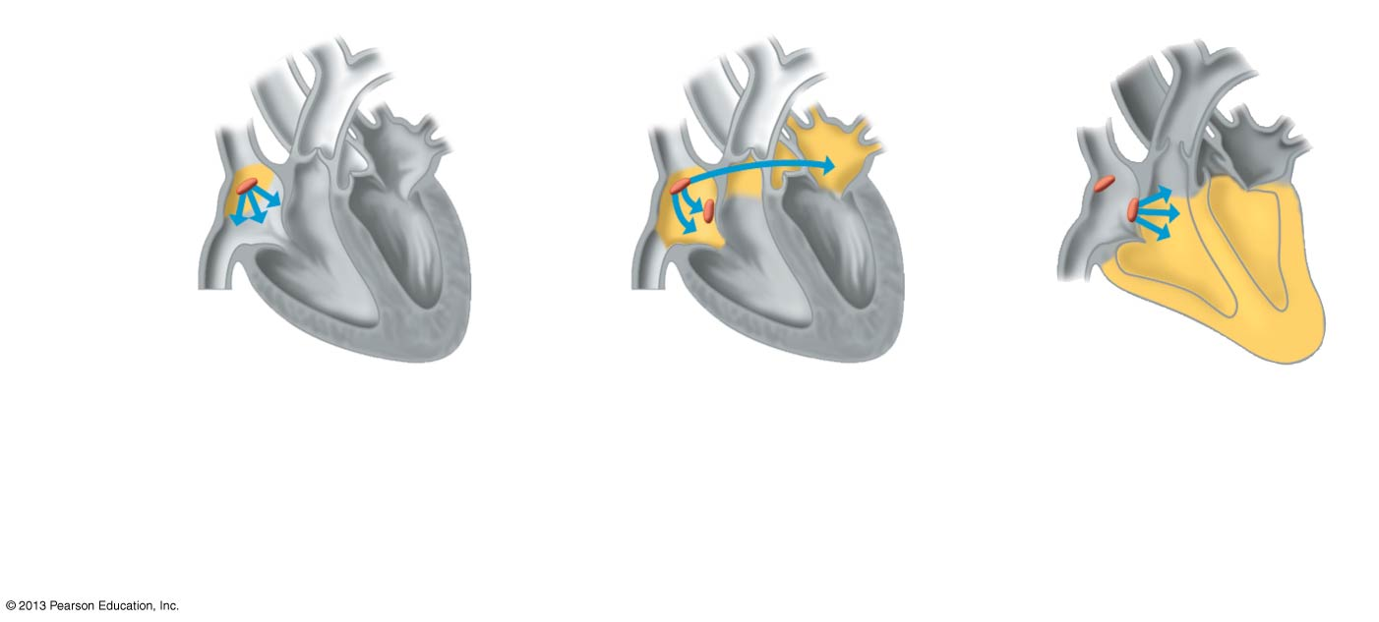
The heart’s natural pacemaker
Pacemaker
(SA node)
AV node
Right
atrium
Right ventricle
1
Pacemaker generates
electrical impulses.
2
Impulses spread
through atria.
3
Impulses reach
ventricles.

Slide 26
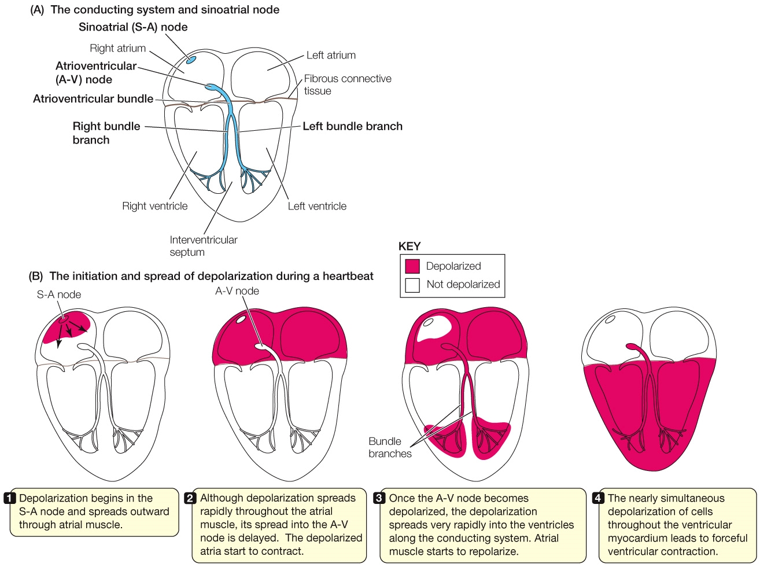
Additional Slides

Slide 27
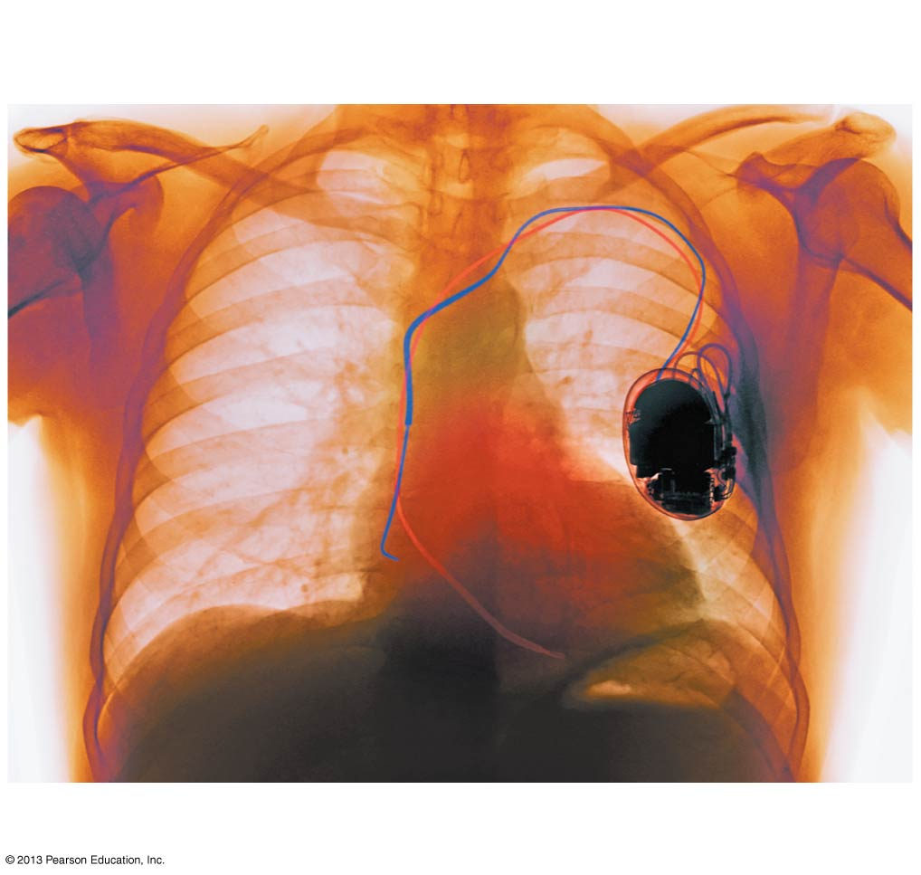
Artificial pacemaker
Wire leading
to SA node
Heart
Artificial
pacemaker

Slide 28
Blood Vessels
  If the heart is the body’s “pump,” then the “plumbing” is the system of arteries, veins, and capillaries.
    Arteries carry blood away from the heart.
    Veins carry blood toward the heart.
    Capillaries allow for exchange between the bloodstream and tissue cells.
Notes:
28

Slide 29
Blood Vessels
  All blood vessels are lined by a thin layer of tightly packed epithelial cells.
  Structural differences in the walls of the different kinds of blood vessels correlate with their different functions.
Notes:
29

Slide 30
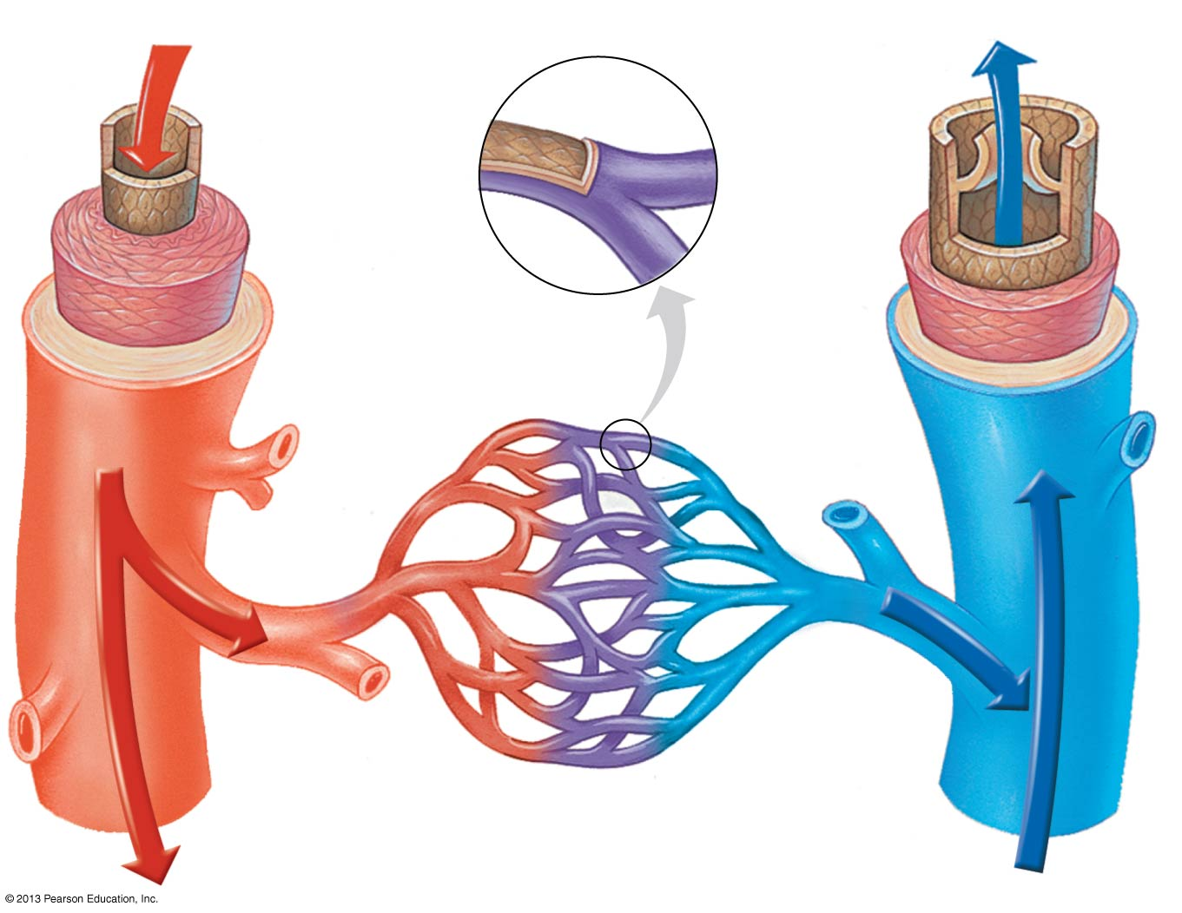
The Structure of Blood Vessels
From heart
Endothelium
To heart
Valve
Endothelium
Endothelium
Smooth
muscle
Smooth
muscle
Connective
tissue
Connective
tissue
Artery
Vein
Arteriole
Venule
Capillary

Slide 31
Blood Flow through Arteries
  The force that blood exerts against the walls of blood vessels is blood pressure.
    Blood pressure pushes blood from the heart to the capillary beds.
    A pulse is the rhythmic stretching of the arteries caused by the pressure of blood forced into the arteries during systole.
Notes:
31

Slide 32
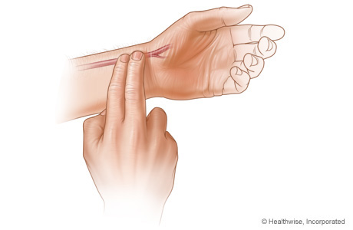
Pulse rate ---- resting heart rate
Your resting heart rate indicates how efficiently your heart pumps blood throughout your body, your pulse rate is a useful tool for gauging your fitness level.
Average adults : 60-100 beats per minute
Conditioned athlete and other highly fit individuals: 40-60 beats per minute
You can check your own pulse rate by putting two fingers over the radical artery, and count the number of beats for 15 seconds.

Slide 33
Blood Flow through Arteries
  Optimal blood pressure for adults is
    < 120 mmHg for systolic (results from blood being forced into the arteries during ventricular systole)
    < 80 mmHg for diastolic (is the pressure in the arteries during ventricular diastole)
  High blood pressure, or hypertension, is persistent
    systolic blood pressure > 130 mmHg, and/or
    diastolic blood pressure > 80 mmHg
Notes:
33

Slide 34
Blood Flow through Capillary Beds
  The walls of capillaries are thin and leaky.
    At the arterial end of the capillary, blood pressure pushes fluid rich in oxygen, nutrients, and other substances into the interstitial fluid.
    At the venous end of the capillary, CO₂ and other wastes diffuse from tissue cells into the interstitial fluid, and then into the capillary bloodstream.
Notes:
34

Slide 35
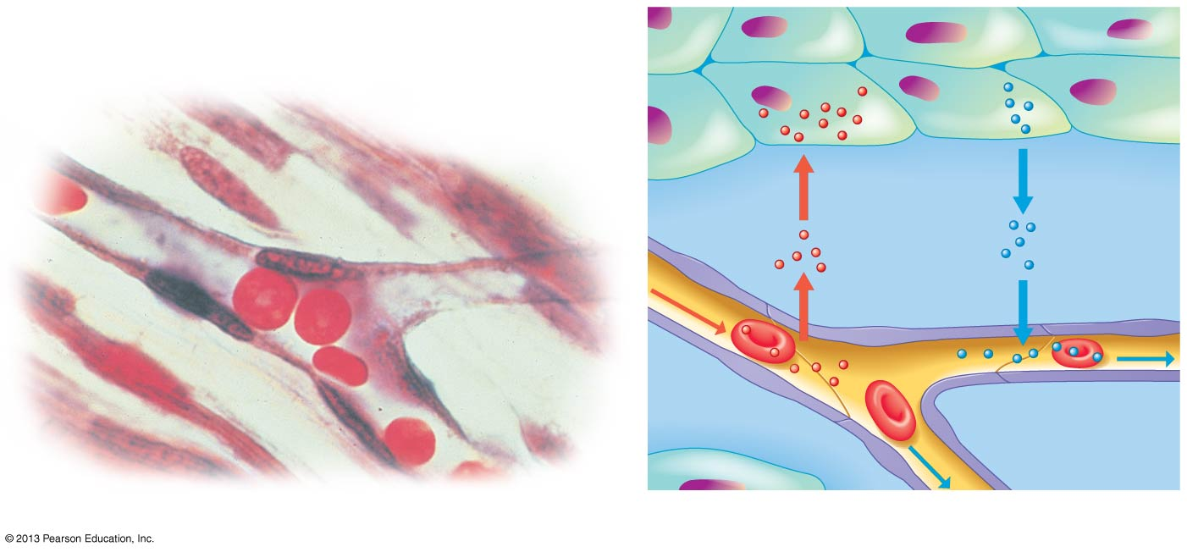
Capillary
Tissue cell
Red blood cell
Diffusion
of O₂ and
nutrients out
of capillary
and into
tissue cells
Diffusion
of CO₂ and
wastes out
of tissue
cells and
into capillary
From
artery
To vein
Interstitial fluid
LM
To vein
(a) Capillaries
(b) Chemical exchange

Slide 36
Blood Flow through Capillary Beds
  At any given time, only about 5–10% of the capillaries have a steady flow of blood.
  Blood flow through capillaries may be diverted from one part of the body to another, depending on need.
Notes:
36

Slide 37
Blood Return through Veins
  Blood returns to the heart
    after chemicals are exchanged between the blood and body cells
    at a pressure that has nearly dropped to zero
Notes:
37

Slide 38
Blood Return through Veins
  Blood moves back toward the heart because of
    surrounding skeletal muscles that compress the veins
    one-way valves that permit blood flow only toward the heart
Notes:
38

Slide 39
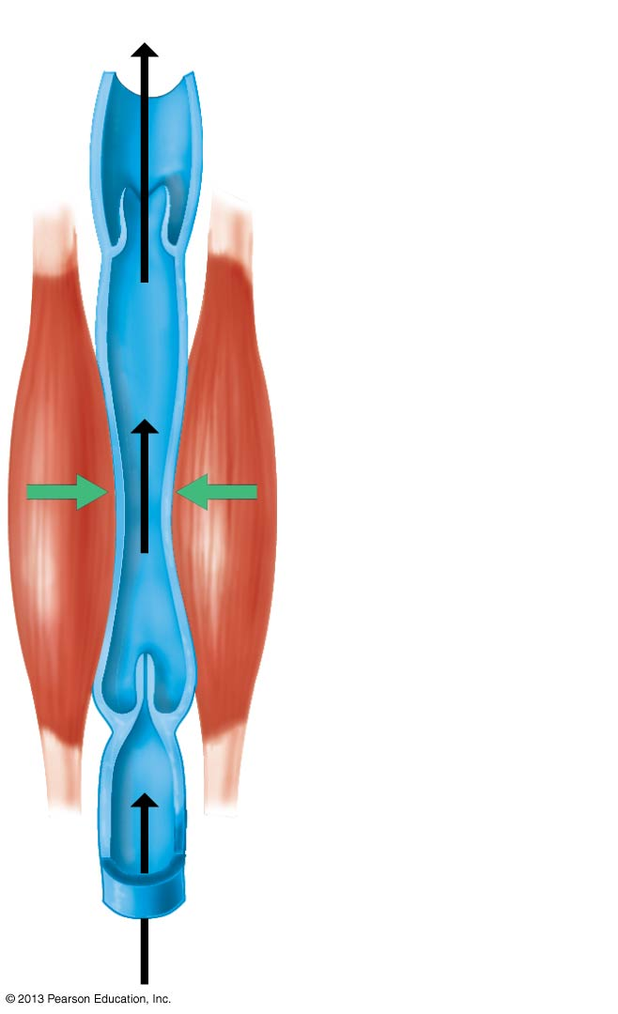
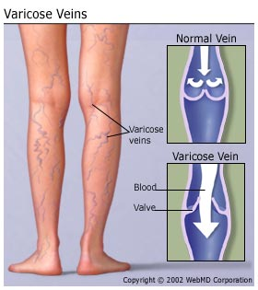
To heart
Blood flow in a vein
Valve (open)
Skeletal muscle
If the valves malfunction, then the blood falls back down to some extent after every muscle contraction and begins to pool in the veins. This causes the veins to swell with blood, which can be painful and unsightly, and is known as varicose veins.
Valve (closed)

Slide 40
Blood
  An adult human has about 5 L (11 pints) of blood.
  By volume, blood is
    a little less than half cells
    a little more than half plasma, consisting of about
      90% water
      10% dissolved salts, proteins, and other molecules
Notes:
40

Slide 41
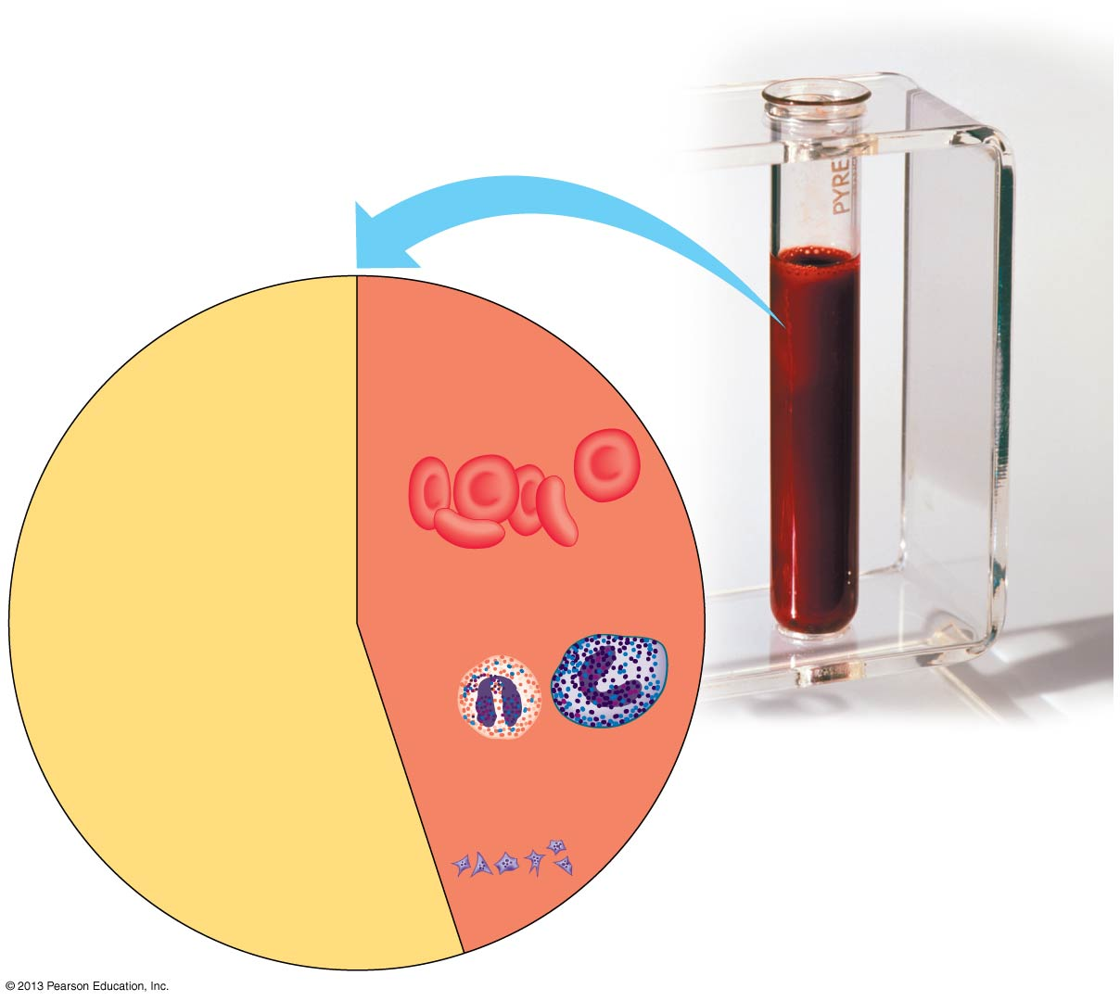
The Composition
of Human Blood
Plasma
(55%)
Cellular
elements (45%)
Water (90%
of plasma)
Red blood cells
(erythrocytes)
Proteins
Dissolved salts
(such as sodium,
potassium, calcium)
White blood cells
(leukocytes)
Substances being
transported (such
as O₂, CO₂, nutrients,
wastes, hormones)
Blood
Platelets

Slide 42
Blood
  There are three types of cellular elements in blood:
    red blood cells
    white blood cells
    platelets
Notes:
42

Slide 43
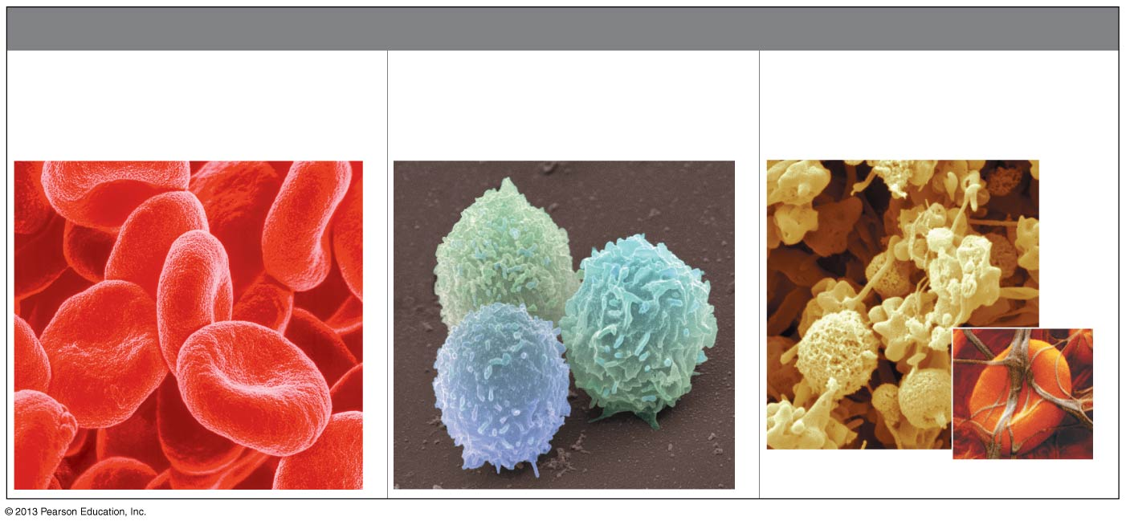
The Three Cellular Components of Blood
CELLULAR COMPONENTS OF BLOOD
Red Blood Cells
(cells that carry oxygen)
White Blood Cells
(cells that fight infection)
Platelets
(bits of membrane-enclosed
cytoplasm that aid clotting)
Colorized SEM
Fibrin
Colorized SEM
Colorized SEM
Red blood cell

Slide 44
Red Blood Cells and Oxygen Transport
  Red blood cells (RBC, erythrocytes)
    the most numerous type of blood cell
    shaped like discs with indentations in the middle.
erythro = red; cyte = cell (erythrocyte: a red blood cell)
Notes:
44

Slide 45
Red Blood Cells and Oxygen Transport
  The main function of red blood cells is to transport oxygen.
  Carbohydrate-containing molecules on the surface of red blood cells determine the blood type.
Notes:
45

Slide 46
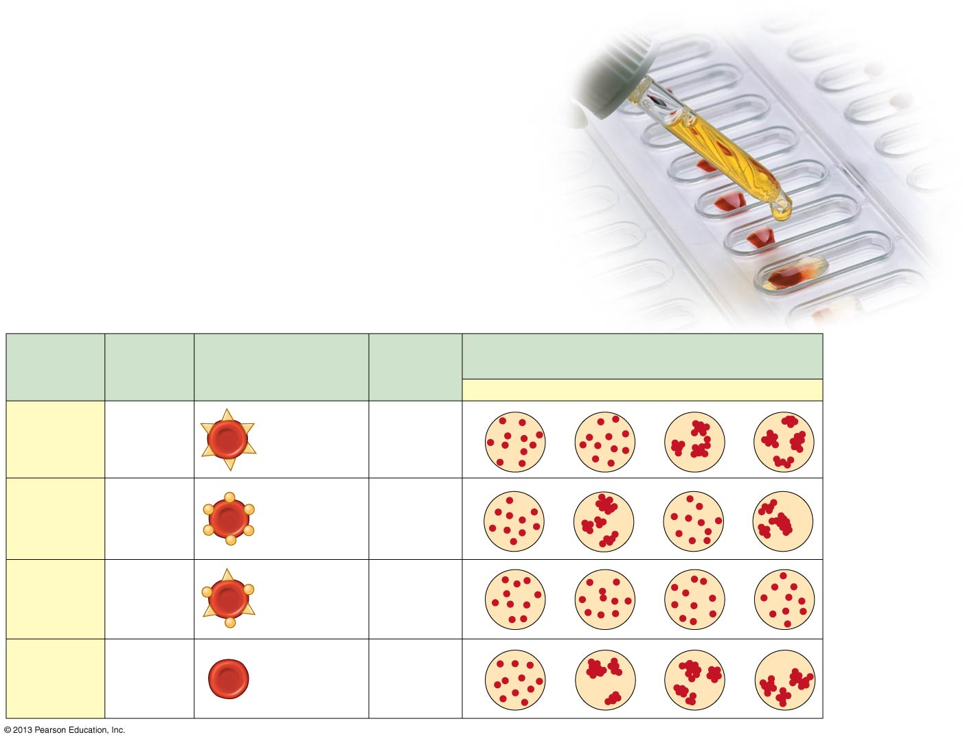
Multiple Alleles for the ABO Blood Groups
Blood
Group
(Phenotype)
Antibodies
Present in
Blood
Reactions When Blood from Groups Below
Is Mixed with Antibodies from Groups at Left
Genotypes
Red Blood Cells
O
A
B
AB
I^{A}I^{A}
or
I^{A}i
Carbohydrate
A
A
Anti-B
I^{B}I^{B}
or
I^{B}i
Carbohydrate
B
B
Anti-A
AB
I^{A}I^{B}
—
O
ii
Anti-A
Anti-B

Slide 47
Red Blood Cells and Oxygen Transport
  Each red blood cell contains approximately 250 million molecules of hemoglobin, which
    contains iron
    transports oxygen throughout the body
Notes:
47

Slide 48
Red Blood Cells and Oxygen Transport
  Anemia （贫血） may result from
    an abnormally low amount of hemoglobin or
    a low number of red blood cells
  The hormone erythropoietin (EPO) boosts production of red blood cells.
Notes:
48

Slide 49
White Blood Cells and Defense
  White blood cells (leukocytes)
    fight infections
    larger than red blood cells
    lack hemoglobin
    are much less abundant than red blood cells (about 700 times fewer).
leuk = white; cytes = cells
Notes:
49

Slide 50
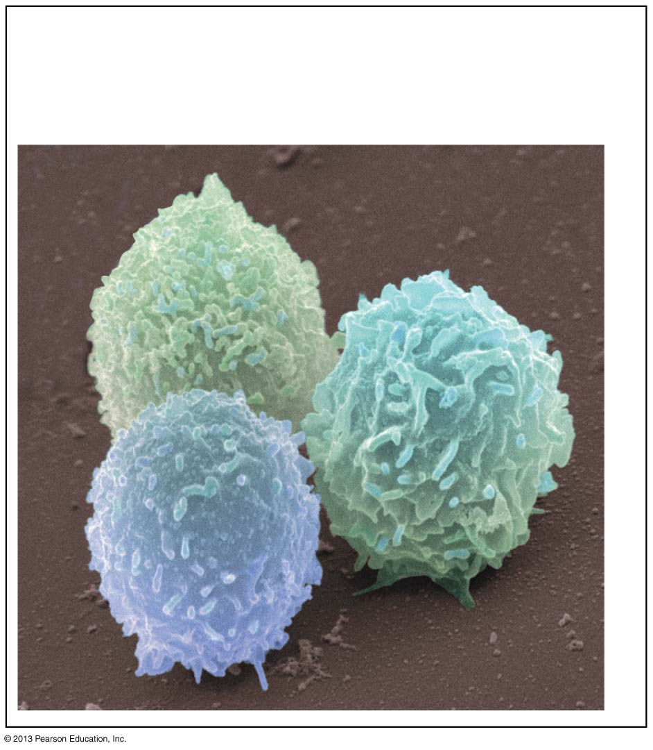
White Blood Cells
(cells that fight infection)

Slide 51
Platelets and Blood Clotting
  Blood contains two components that aid in clotting:
    Platelets, bits of cytoplasm pinched off from
    larger cells in the bone marrow
    Clotting factors released from platelets that
    convert fibrinogen, a protein found in
    plasma, into a threadlike protein called fibrin.
fibrino = a fiber; gen = produce (fibrinogen: the inactive form of the plasma protein that is converted to the active form fibrin, which aggregates into threads that form the framework of a blood clot)
Notes:
51

Slide 52
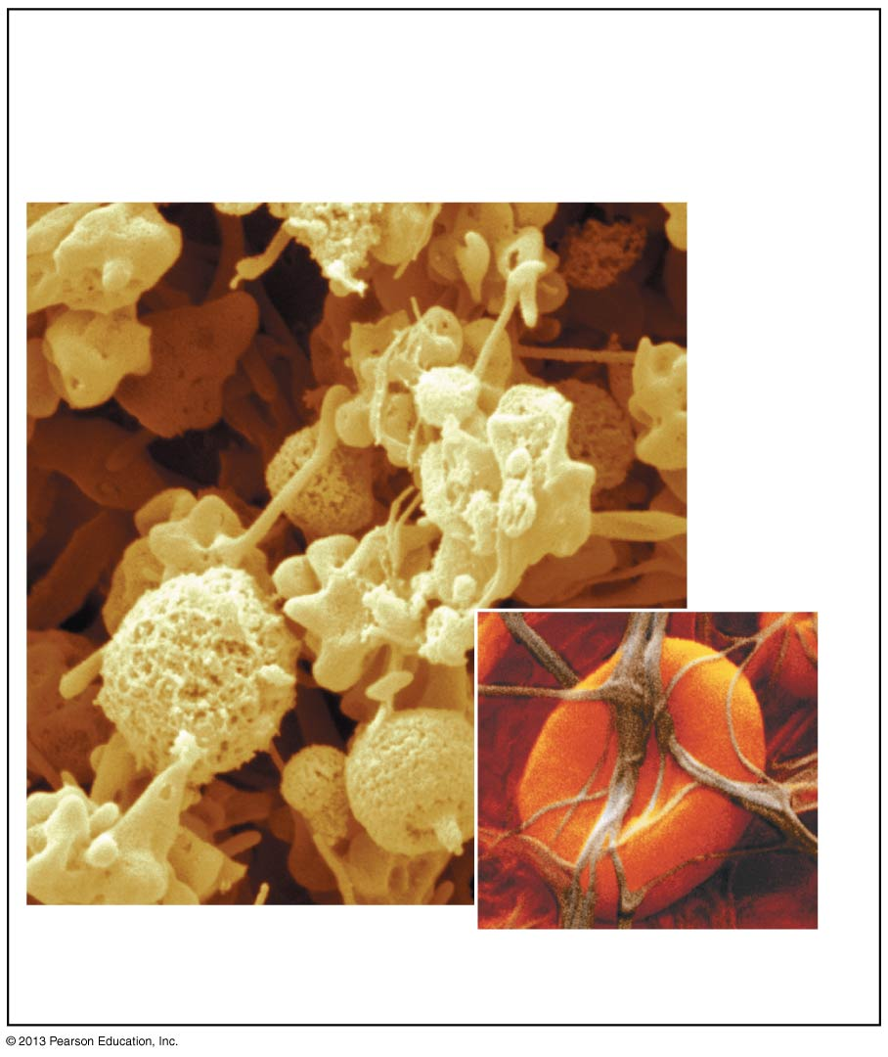
Platelets
(bits of membrane-enclosed
cytoplasm that aid clotting)
Fibrin
Red blood cell

Slide 53
Platelets and Blood Clotting
  In the inherited disease hemophilia （血友病）, excessive and sometimes fatal bleeding can occur from even minor cuts and bruises.
  Hemophilia is caused by a genetic mutation in one of several genes that code for clotting factors.
Notes:
53

Slide 54
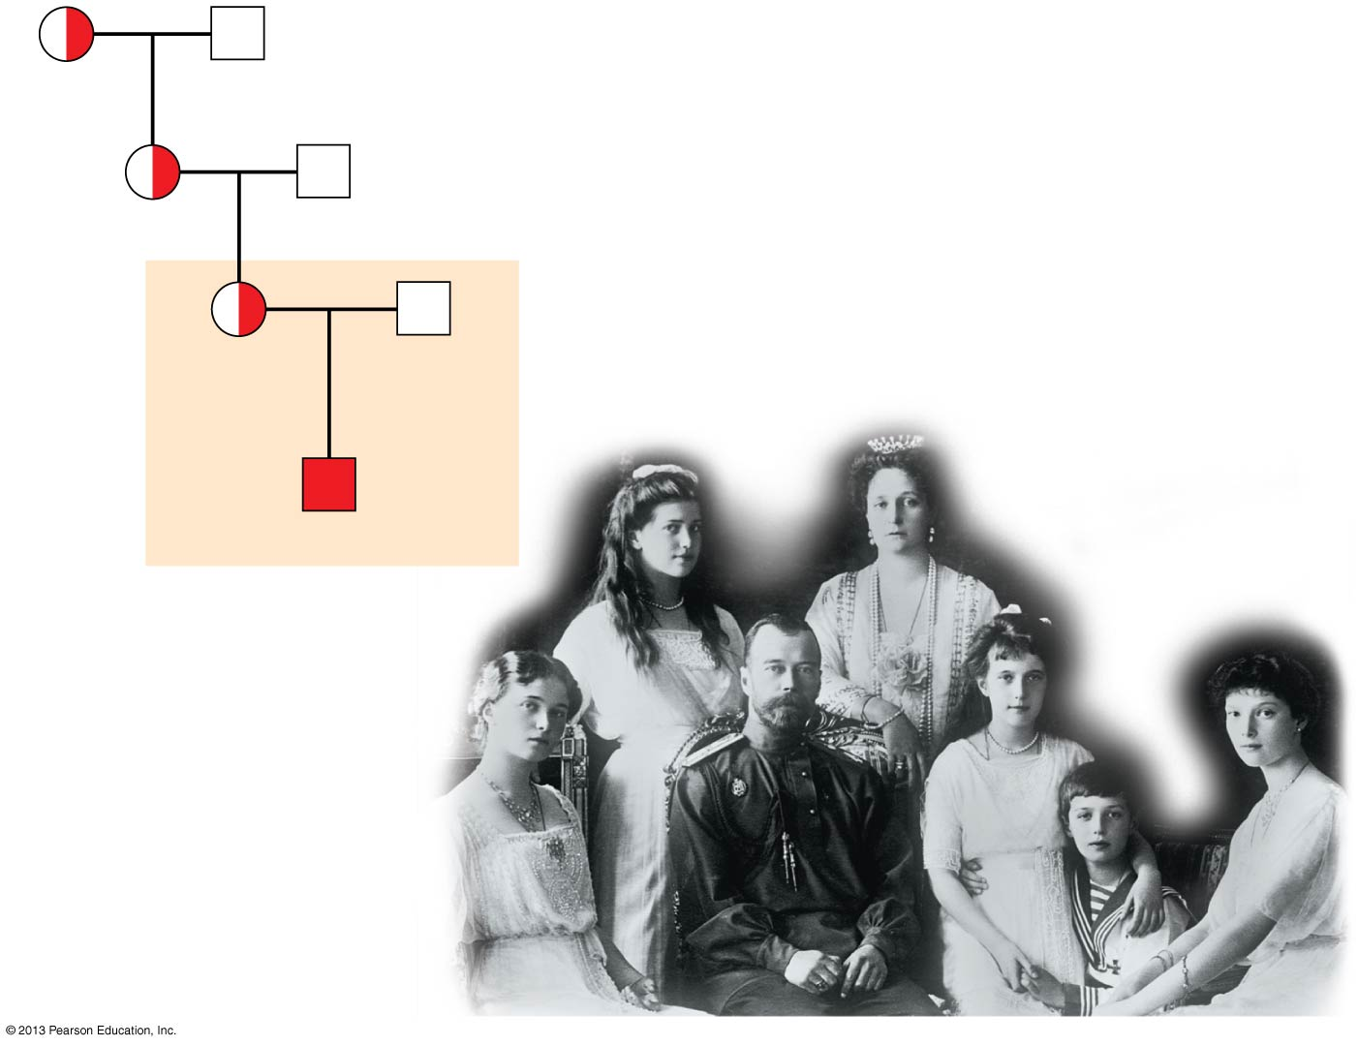
Hemophilia in the Royal Family of Russia
Queen
Victoria
Albert
Alice
Louis
Alexandra
Czar
Nicholas II
of Russia
Alexis

Slide 55
Stem Cells and the Treatment of Leukemia
  Leukemia
    cancer of white blood cells
    may require treatment using
      radiation
      chemotherapy, and/or
      bone marrow transplantation
Notes:
55

Slide 56
Cardiovascular Disease
  Cardiovascular disease
    includes all diseases affecting the heart and blood vessels
    accounts for 40% of all deaths in the United States
    kills more than 1 million people each year
Notes:
56

Slide 57
Cardiovascular Disease
  Coronary arteries
    supply the heart muscle
    can narrow or close, contributing to a heart attack
Notes:
57

Slide 58
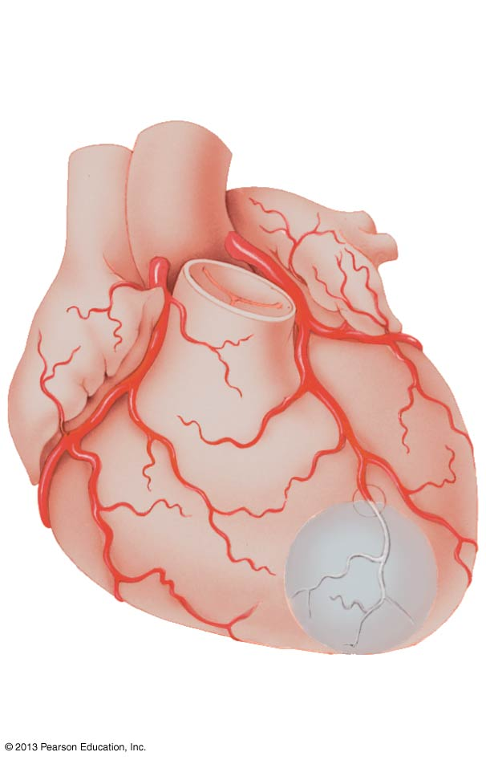
Blockage of a coronary artery, resulting
in a heart attack
Aorta
Coronary artery
(supplies oxygen
to the heart muscle)
Dead muscle
tissue
Blockage

Slide 59
Cardiovascular Disease
  Atherosclerosis
    a chronic cardiovascular disease
    results from fatty deposits called plaque that develop in the inner walls of arteries, clogging the passages through which blood can flow.
Notes:
59

Slide 60
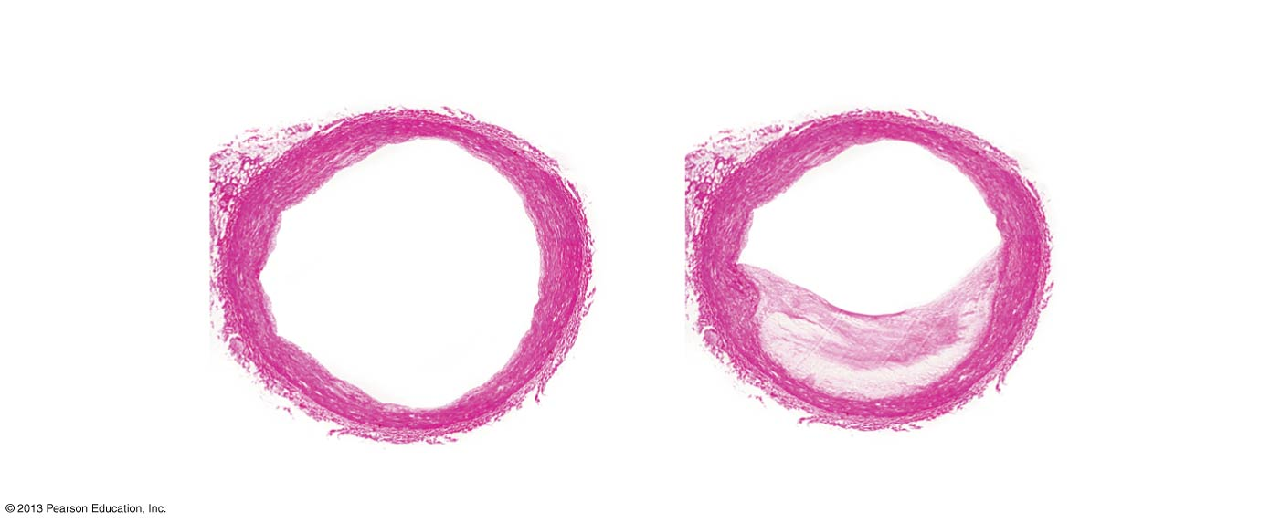
A Normal Artery and an Artery Showing Atherosclerosis
Passageway
for blood
Smooth
muscle
tissue
Partially blocked
passageway
Connective
tissue
Plaque
Epithelium
Normal artery
Artery partially
blocked by plaque

Slide 61
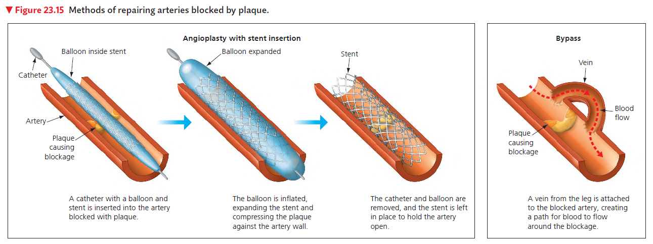

Slide 62
Cardiovascular Disease
  Cardiovascular disease
    involves inherited factors, but
    can be reduced by
      not smoking
      exercising regularly
      eating a heart-healthy diet
Notes:
62

